Slide 1
Building your
Candidate Personas

Slide 2
COMMUNICATION
EXPERIENCE
Likes to talk via text and FB Messenger.
Prefers email over phone calls.
Is working 9-5 best times to engage are early morning or evenings 9pm -11pm.
Has worked in HR for the past 5 years
Started as a recruiter
Is now a Sr. Recruitment Associate??
Manages a team of 5 people
Works for a large company, 30,000 employees
SOCIAL MEDIA PRESENCE
Is active on LinkedIn, Facebook and Instagram
FAMILY LIFE
Married
2 young children
Balances full time job and household responsibilities
Is on the PTA committee
JOB SEARCH
Mostly LinkedIn
Is not on job boards
PROFESSIONAL MOTIVATIONS
Development via online courses
Moving up the corporate ladder
SOFT SKILLS
Leadership
Good communicator
Proactive
Gets stuff done
TECH BEHAVIORS
Uses task management tools like Asana and Trello
Relies on apps on her phone for daily life
Attends virtual meetings using popular systems like Zoom or Hangouts
Uses simple systems, no programming or coding skills
HARD SKILLS
PERSONAL INFORMATION
Tools
CRM
ATS
Data mining, analysis
Carrie Fischer
30-35 years old
College grad
Mid-level
talkpush.com

Slide 3
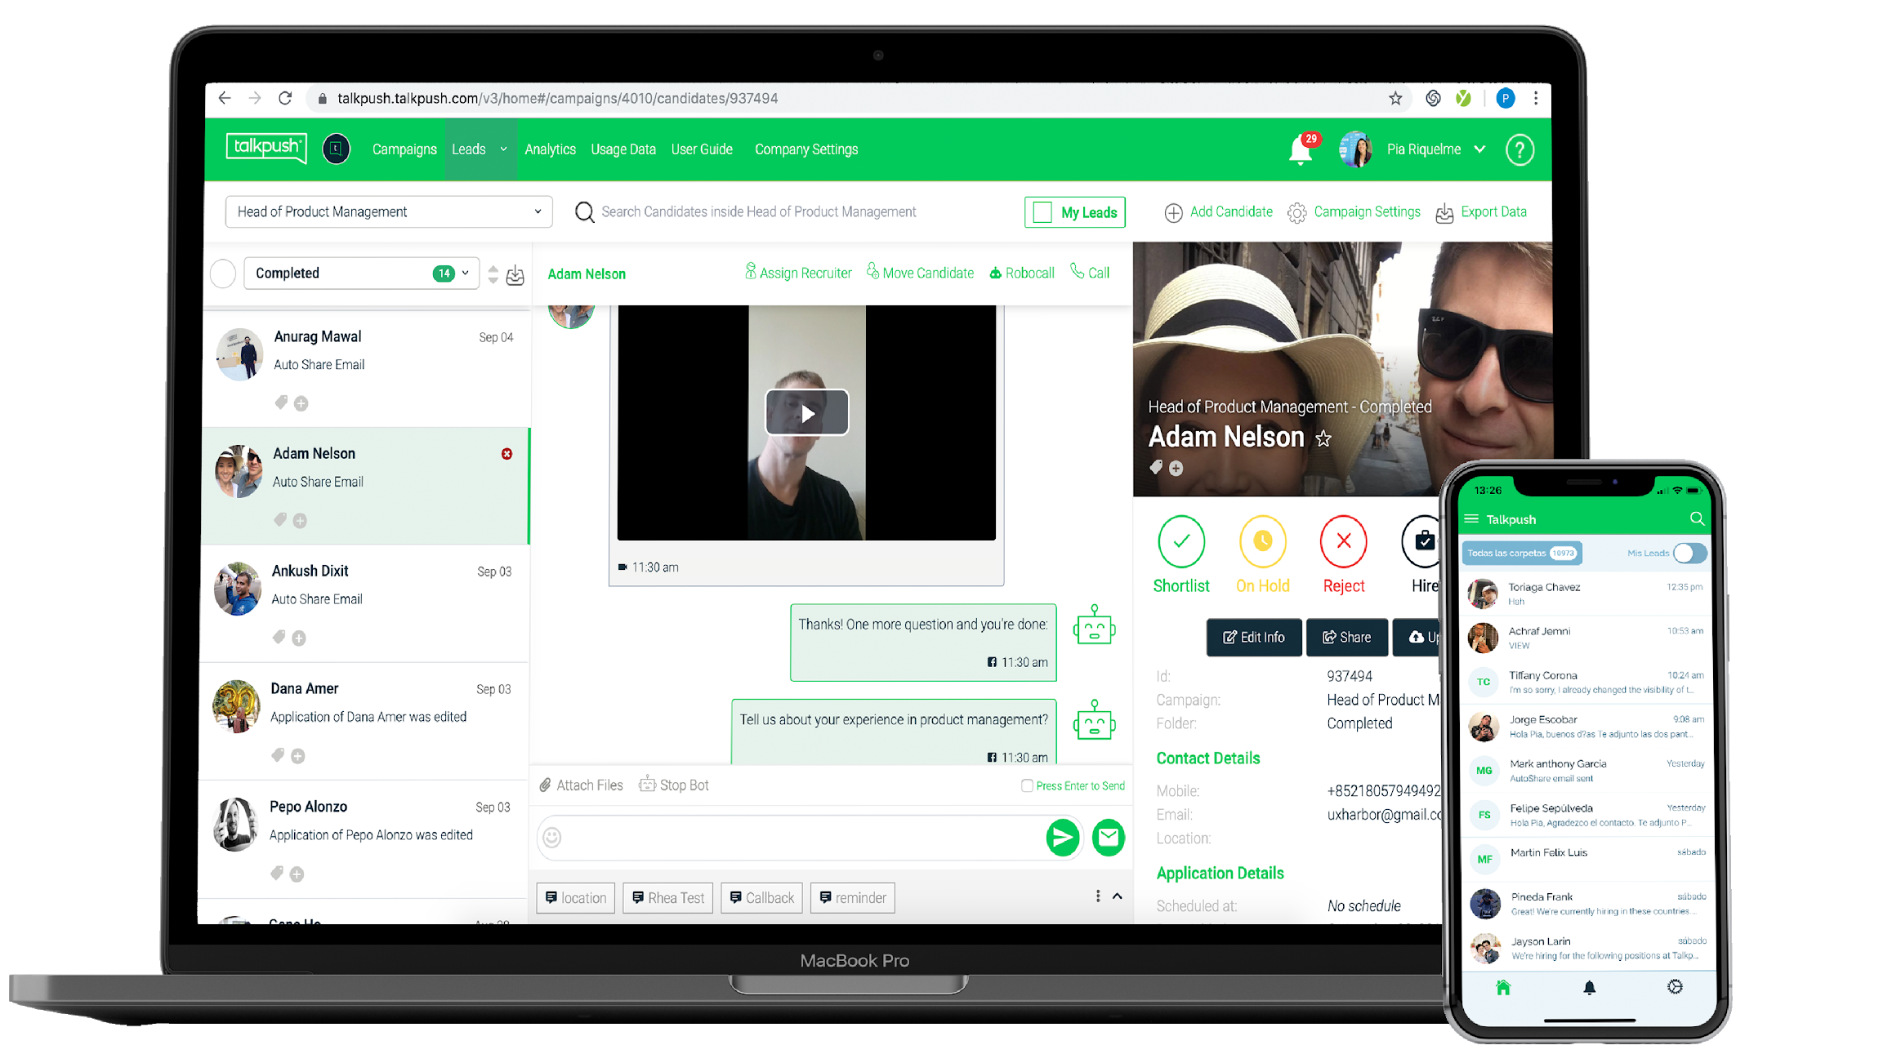
The recruitment automation platform
learn more at
talkpush.com

